Slide 1
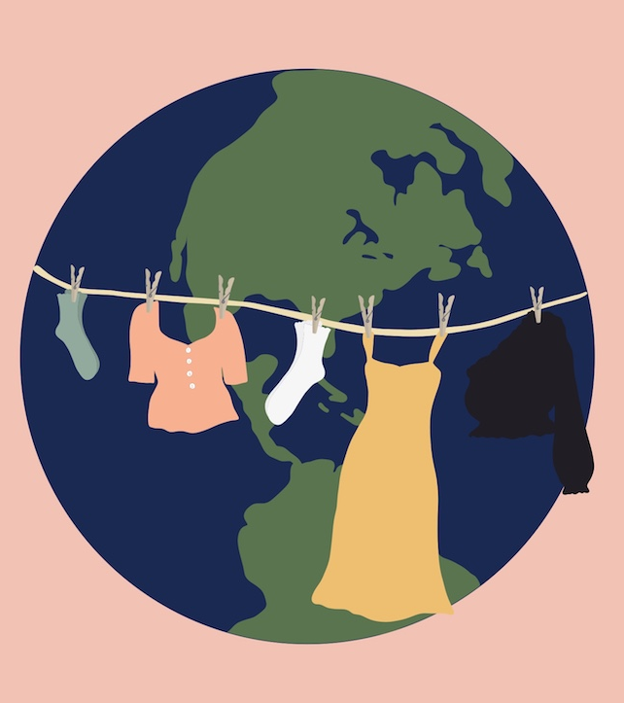
Sustainable Shopper
Team Tada
Aditya Dave, Pannawat Chauychoo,
Sanjana Baliga, Yu Liu
Image Credit: https://hellogiggles.com/fashion/sustainable-clothing-fame-and-partners-frilly/

Slide 2
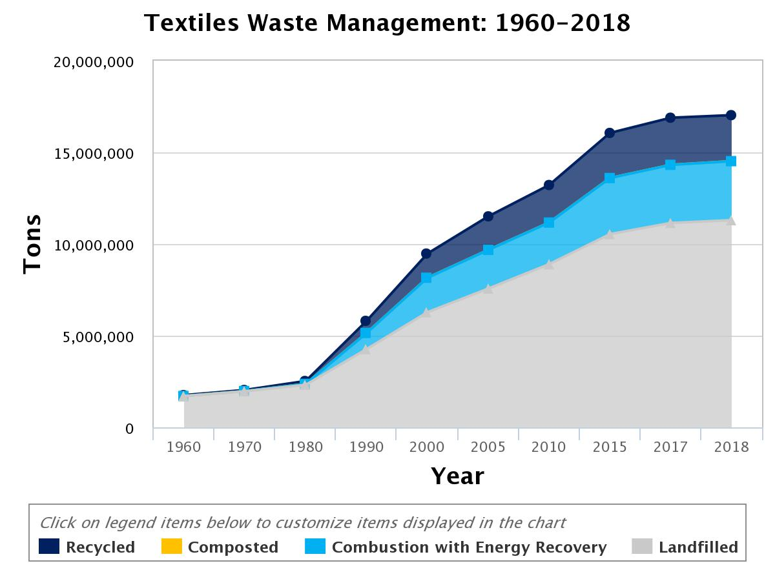
The Problem: Fast Fashion
The fashion industry is the 2nd most polluting industry in the world
Around 85% of all textiles thrown away in the US are either dumped into landfill or burned
Currently only about 13% of clothes and shoes thrown away in the US end up being recycled
Source: United States Environmental Protection Agency

Slide 3
Sustainable Shopper
The Idea Scan label on clothes to find material composition, and generate a sustainability score to help the consumer choose between clothing items
Social Impact To help the consumer make more sustainable choices during an in-store shopping experience
To put pressure on brands to make their supply chain more sustainable

Slide 4
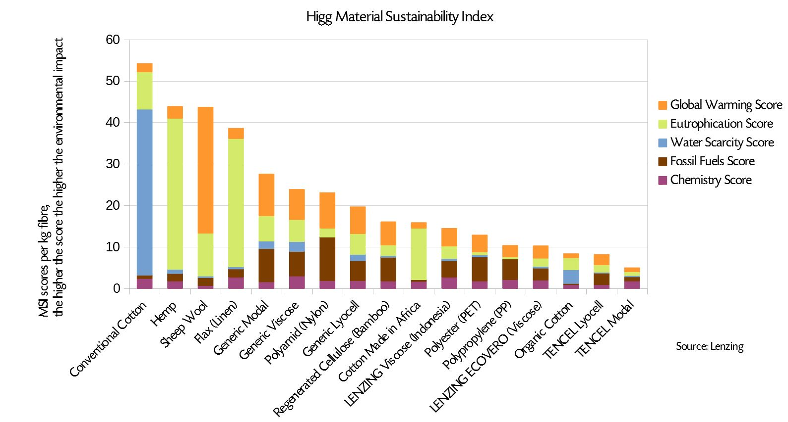
Dataset Creation
Data sources
Water Footprint Network
The World Counts
Higgs Index
Features considered
Resources Used
Environmental Impact

Slide 5
Technical Solution
Input
Image of label
OCR using pytesseract
(pre-trained)
Extract material composition
Compute sustainability score
Output
Recommend article

Slide 6
Impact
Challenges
Limited data available to fine-tune OCR
Sustainability scores have to be vetted by experts
Scalability
Application can be deployed on mobile devices and run offline, provided data about materials is updated on a regular basis
Future Work
Recommend sustainable alternatives to the material
Consider more features (ethicality, durability, price, new/used)
Take into account clothes already owned by the consumer

Slide 7
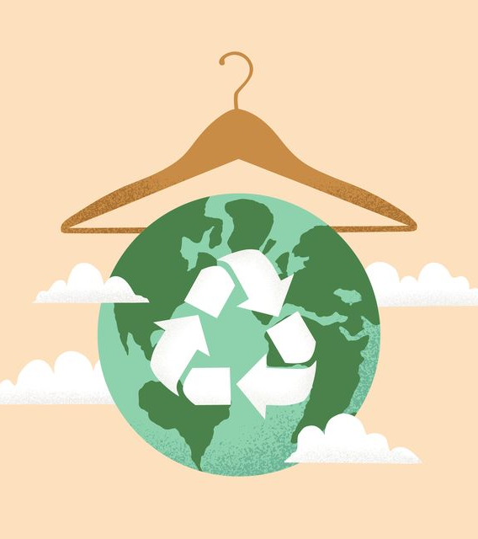
Thank You
Image Credit: Eireenz / Getty Images

